Slide 1
Microsoft Corporation
Lin Yuan Chong (B00130692)
Zygimantas Gaubas (B00122322)
Lim Shien Han (B00122885)

Slide 2
SUMMARY OF COMPANY
SUMMARY
Founded in the year 1975
An American MNC Technology Company.
Microsoft = microcomputer + software.
Software services, devices and solutions.
HISTORY
Interpreters for the Altair 8800 back in April 4, 1975.
1980s, targets to run on personal computer (Microsoft Windows).
Windows 10, newest Windows OS.
FOUNDER
William (Bill) H.Gates III, founder.
Born in Seattle on 28th October 1955.
Paul Allen, co-founder.
Gates’ childhood friend.
MISSION & VISION STATEMENT
To create innovative technology.
Accessible to everyone.
Adapts to each person’s needs.
Make technology a public asset.

Slide 3
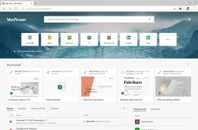
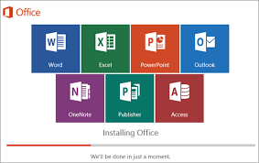
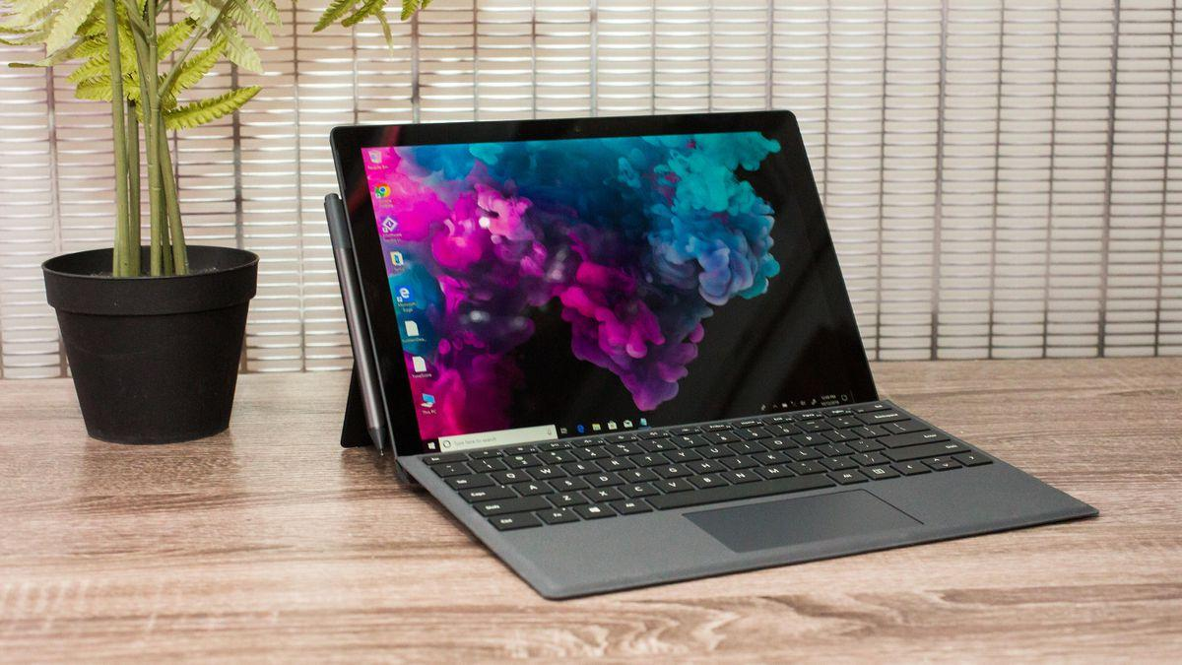
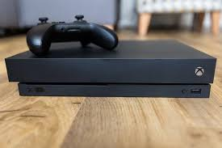
PRODUCT / SERVICE OFFERED
Softwares
Hardwares
Edge
Office
Surface
Xbox

Slide 4
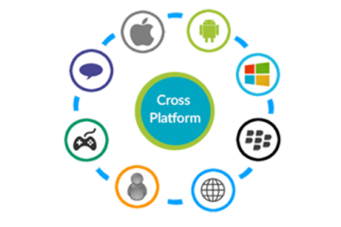
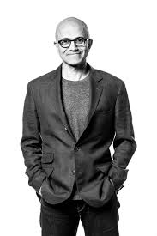
WHAT MAKES THE COMPANY UNIQUE
Products are platform independent.
Lead by great leaders (Satya Nadella).

Slide 5
SWOT ANALYSIS
S
W
O
T
Strengths
Weaknesses
Opportunities
Threats

Slide 6
SWOT ANALYSIS (cont.) (Strengths & Weaknesses)
S
W
Strengths
Weaknesses
World leading software provider.
Strong distribution network.
Excellent reputation.
User friendly.
Lacking innovation in expanding hardware product.
Unprofitable investment.

Slide 7
SWOT ANALYSIS (cont.) (Opportunities & Threats)
O
T
Opportunities
Threats
Built huge capital.
Massive team.
Facilities and headquarters all over the world.
Google, Apple.
Harmful OS updates.
Changing habits of consumers.

Slide 8



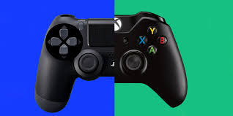
KEY COMPETITORS
Gaming Consoles
SONY
PlayStation 4 Pro
MICROSOFT
Xbox One X

Slide 9

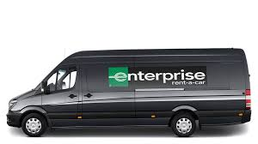
TARGET MARKET
Home users
Personal computing.
Entertainment.
45 billion revenue (2019).
Enterprises
Productivity and business processes.
41 billion revenue (2019).

Slide 10
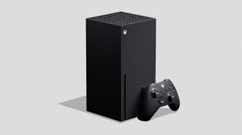
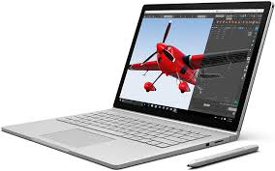
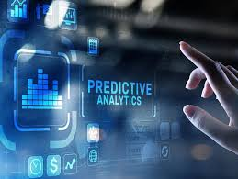
FINANCIAL POSITION
New gaming console.
New laptops.
New technology.

Slide 11
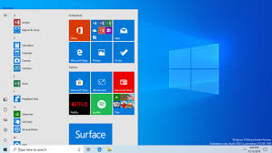

LEADERS / FOLLOWERS IN INDUSTRY
Microsoft Windows OS.
Microsoft Azure.

Slide 12



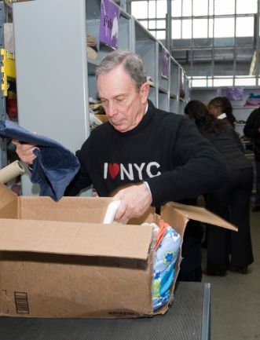

ADDITIONAL RELEVANT INFORMATION
The Corporate Social Responsibility (CSR) of Microsoft Corporation
Environment Sustainability
Privacy & Cyber Security
Skill & Employability
Microsoft Philanthropies

Slide 13
~THE END~
THANK YOU.

